Slide 1
Understanding Trauma and Providing Comfort Virtual Event with the National Bikur Cholim Conference
February 24, 2025

Slide 2
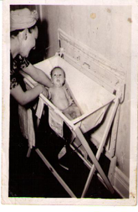
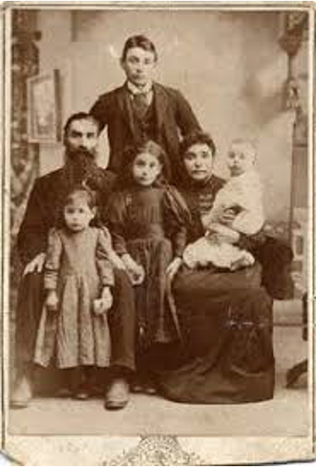
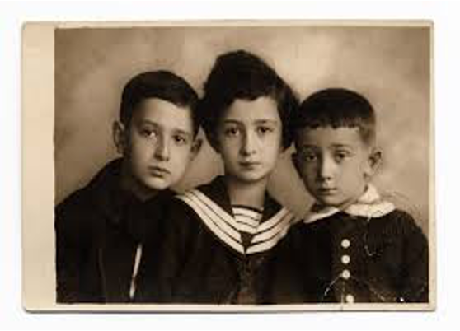
“The past is never dead. It’s not even past.”
—William Faulkner

Slide 3
Our lives are the current blossom on a
family tree that is thousands of years old

Slide 4
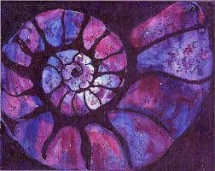
Those whom we tend carry within them generations of history, the wisdom and the traumas of their people

Slide 5
Interoception
Inner focus and awareness of our subtle physical sensations; Mindful self-attunement
Notes:
Photo of Gabor?

Slide 6
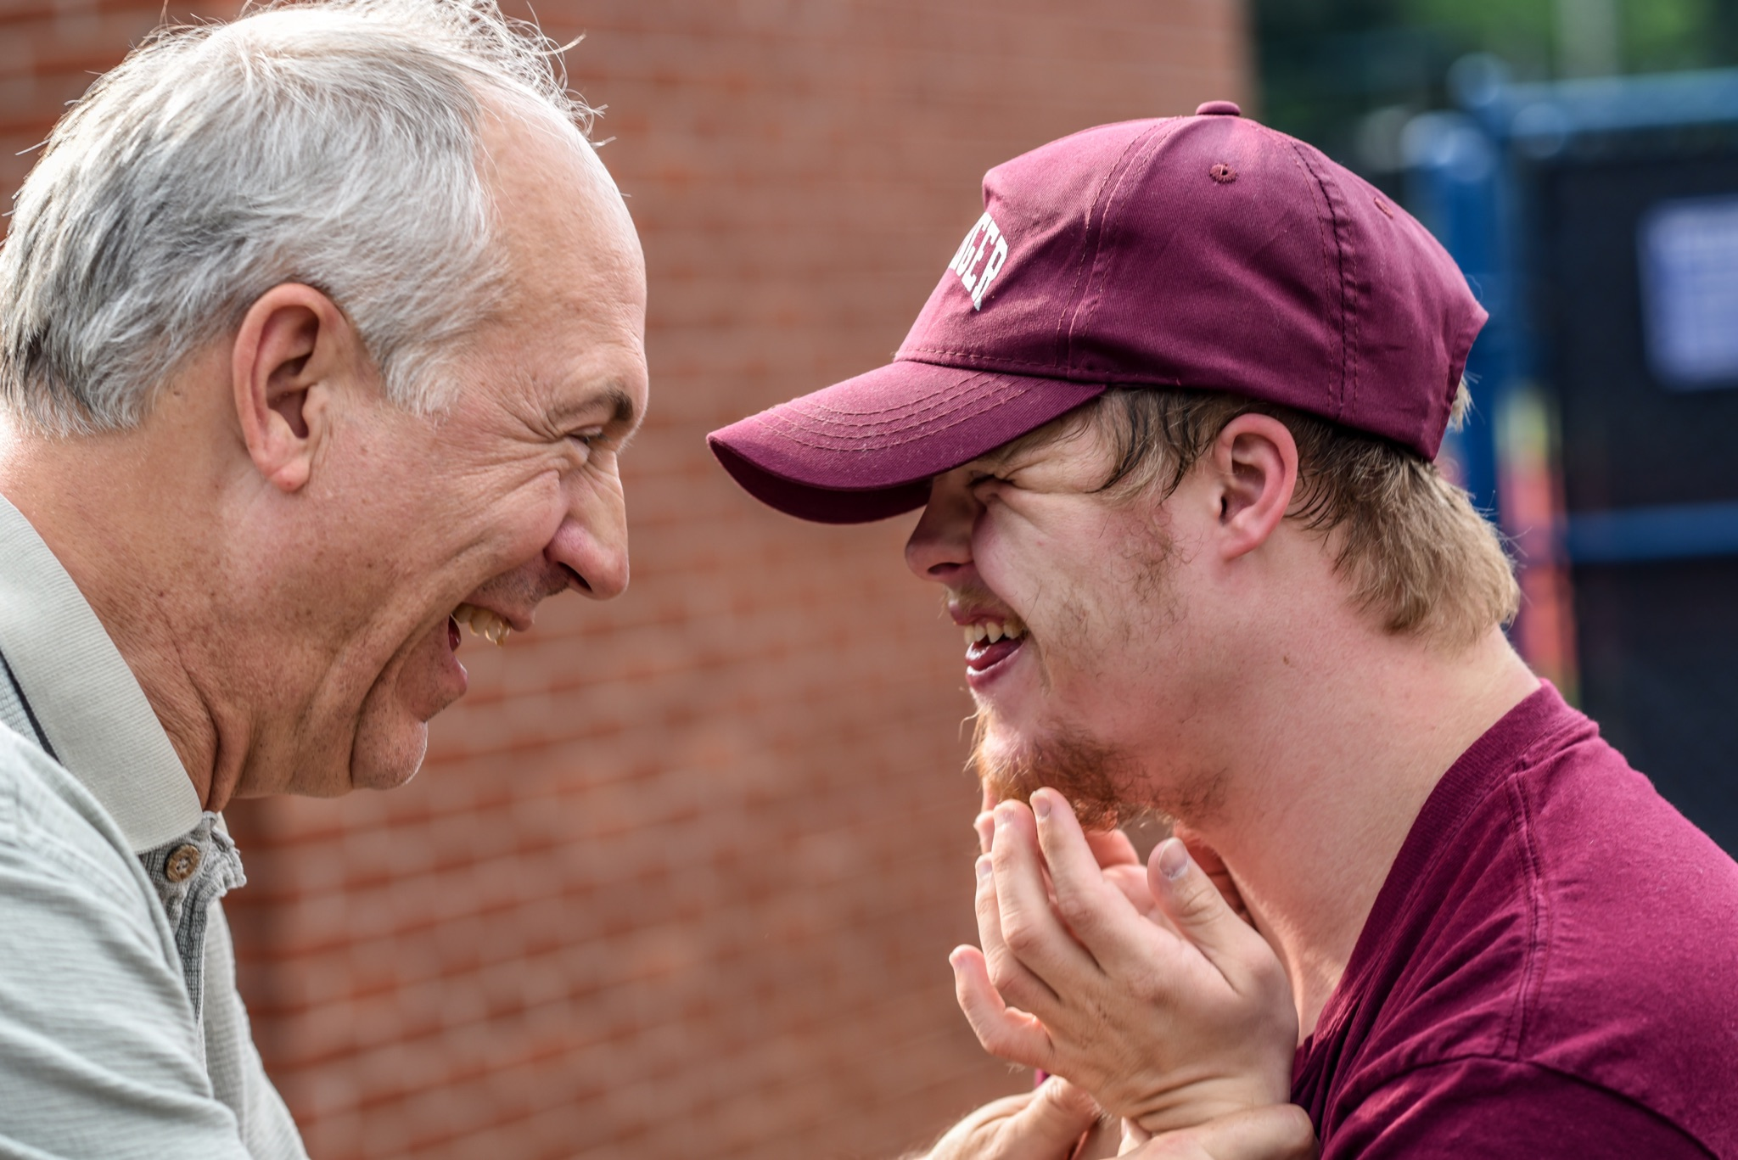
Attunement
Kinesthetic and emotional sensing of another being
Notes:
Photo of Gabor?

Slide 7
Minding the “Window of Tolerance”
The zone of arousal within which we can comfortably grow.

Slide 8
Witnessing
Being fully present with another human being without judgment or agenda, taking in their lived experience
Notes:
Photo of Gabor?

Slide 9
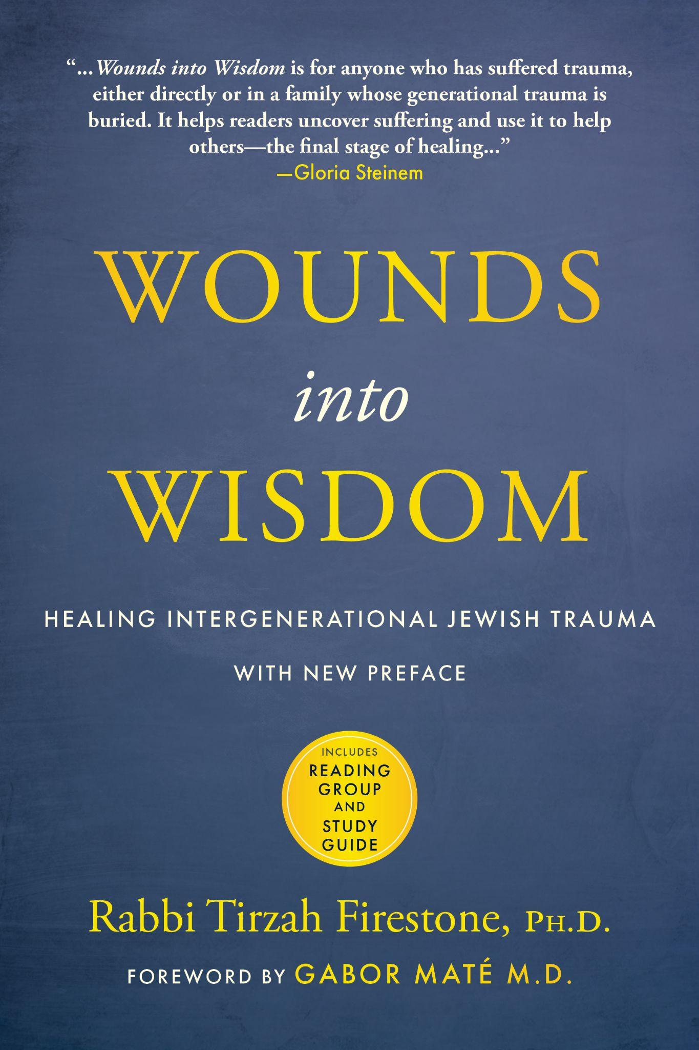
The Healing Power of Witnessing
“Being witnessed allowed me to survive.”
Notes:
Photo of Gabor?

Slide 10
“Something deep in the psyche shifts when we know we are not alone. Without human eyes and ears to share in our reality, our suffering can become meaningless and unbearable.”
—from Wounds into Wisdom, Tirzah Firestone

Slide 11
Trauma
Greek for “wound”
Trauma is the residue of any deeply distressing life experience that overwhelms our coping capacities.
“Trauma is anything the body perceives as too much, too fast, too soon.”
—Resmaa Menakem
Notes:
“Trauma is anything the body perceives as too much, too fast, too soon.” —Resmaa Menakem

Slide 12
Intergenerational Trauma
The unhealed residue of extreme life experiences that is transferred to future generations.
“I am a Jew, and there are scenes of the Holocaust that are indelibly etched in my mind, even though I was not alive at the time.”
—Chemi Shalev

Slide 13
Collective Trauma
An event or series of events that shatters the experience of safety for a group or groups of people.
“Collective trauma is… a shared experience that alter(s) the narrative and psyche of a group or community.”
—Leia Saltzman

Slide 14
The 4 Hallmarks of Trauma
Dissociation (psychic numbing)
2. Hyper-Arousal (hyper-reactivity)
3. Isolation (feelings of shame)
4. The Tendency to Repeat or Reenact Injuries on ourself or others

Slide 15
-Which of these trauma residues are familiar to you from your family of origin?
-Are any of them currently active?
-Have you noticed them showing up in those in your care?

Slide 16
How do you stay within your own Window of Tolerance, so you can remain grounded in your work
with others?

Slide 17
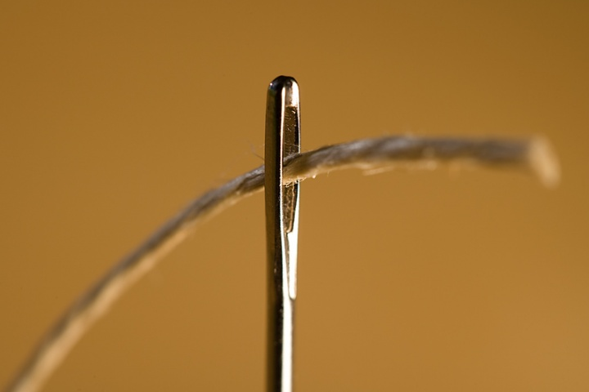

Slide 18
Waterfall Breathing

Slide 20
Connecting to the loving and wise legacies of our ancestors

Slide 22
www.tirzahfirestone.com

