Slide 1
Caring for the Caretaker
Bikur Cholim during the Covid 19 pandemic-Jan. 18, 2021
Rabbi / Chaplain Cheryl Weiner, PhD, BCC
Faye Wilbur, LCSW-R

Slide 2
Grounding and Welcome
Breathe---let go of the day; be present to the current moment
Shehechiyanu Prayer---
Baruch Atah Adoshem, Shehechiyanu, Vikiyamanu, V’higiyanu, lazman hazeh!
Blessed are You, G-D, who has given us life, jas sustained us and has brought us to this special time --- to this opportunity to build relationship, renewal, and resilience.
Notes:
Cheryl

Slide 3
Housekeeping
How to use zoom/ muting, chat
Confidentiality--- please don’t share other’s stories without permission.
Speak with “I” statements.
Ask any questions that are of concern to you.
Raise your hand in reactions or Put in Chat
If you have anything you would like to add, please put in the chat and we will try to include.
Notes:
Cheryl

Slide 4
Why We Are Here Together
Notes:
Faye

Slide 5
Who Is a Care Giver? (Source: National Alliance for Caregiving and AARP Report (2009, updated November 2012)
Deﬁnition: Anyone who provides assistance to someone who is incapacitated and needs help.
Informal caregivers: unpaid (family members and friends)
Formal caregivers: volunteer or paid caregivers associated with a service system
65.7 million caregivers make up 29% of the US adult population providing care to someone who is ill, disabled, or aged
By 2020, caregivers will number 80 million

Slide 7
Check-In
Who we both are---Faye Wilbur and Rabbi Cheryl Weiner
Check in with who is on the Zoom---please write in:
Name, where are you from, who are you caring for (relationship)?
Why did you sign up for this session?
What we hope to share with you
Notes:
Faye: Write in Chat

Slide 8
Issues that You Shared AND Stressors Now
Burnout
Systems of prior support are not working; everything is harder
Compassionate Fatigue
Not enough hours in the day
Torn between your caregiving role and your own needs
Moral Distress
Not being able to visit people due to Covid 19 constraints
Moral Injury
The world is out of joint
Uncertainty
Notes:
Cheryl; Faye checks the chat

Slide 9
Approach a Crisis
The Baal Shem Tov (BESHT) offered a three-pronged approach to crises : hachna’ah (yielding), havdalah (discernment), and hamtakah (sweetening).
Hachna’ah-yielding- accept and yield to what is, ze’h ma sheyaish- this is what it is (acceptance)
Havdalah- discernment - understand the spot we are in, separate fact from fiction and move forward wisely in this new reality
Hamtakah- sweetness - be open and curious to new events, and find and create the sweetness in the new reality, learn to appreciate the small and not so small treasures of life.
Notes:
Faye

Slide 10
Some Words of Support
It is not your responsibility to complete the task, but neither are you free to desist from it.
(Pirkei Avot 2:21) "Time is out of joint.”
(Shakespeare, Hamlet, Scene 1, Act 5)
Notes:
Cheryl

Slide 11
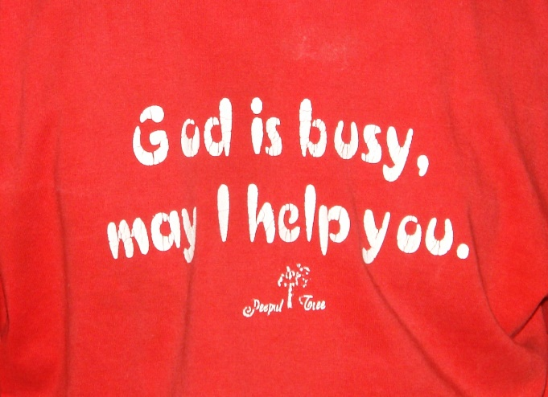
Giving to Others AKA: Benefits of Chesed
Research from Mayo clinic +
Decreases our risk of depression
Gives us a sense of purpose and skills
Helps people stay physically and mentally active and healthy
May reduce stress levels
May increase life expectancy
Expands our network and self confidence
Notes:
Faye

Slide 12
Coping Tools
Acknowledge personal strengths and struggles
Do what you can do, be realistic
Do what you enjoy
Talk to a trusted friend or family member
Laughter with Mary Maxwell –Home Instead Invocation https://www.youtube.com/watch?v=vPFCn3itBFE
Notes:
Faye

Slide 13
Self Care is NOT Selfish! (Olgaphoenix.com)
All about balance!
Physical
Psychological
Emotional
Spiritual
Personal: Social
Professional
Notes:
Cheryl: How are you taking care of yourself---put in chat

Slide 14
Create a Self Care Plan
To better care for myself, I commit to doing the following
Physical: i.e. yoga or tai chi; aerobic activity like running; biking, hiking; strength building like working out, gardening or cleaning; spend time outside
Psychological: ie. Become aware of underlying triggers that cause anxiety or distress and develop a de-escalating strategy for when this occurs; engage in Pet Therapy, find a support group, get “teletherapy”
Spiritual: i.e. meditate, engage in deep breathing or relaxation exercises, attend a service, call someone special, journal your experiences, compose a daily gratitude list, forgive people, pray, say Tehillim (Psalms); read some uplifting texts
Personal/ Social : i.e.; create something through art, music, writing, video, photography, watch a documentary; go on a virtual trip, start a new hobby; call a friend; schedule a coffee meet-up; pick a time for a virtual group hug with folks (Wear masks if engaging with others and physically distance.)
Relaxing: Find time to do something you enjoy! ie listen to or play music, binge watch TV, play videogames; walk your dog; play with your children, take a hot bath, drink a glass of chamomile tea, schedule a massage or aromatherapy session, read a book, bake a cake, cook a meal
As some say, “Let go and let God!”….
Notes:
Cheryl.

Slide 15
Mindfulness: Re-Framing
Notes:
Cheryl

Slide 16
Writing
Choose self expression— Journaling, AKA My Diary
WHAT TO INCLUDE
Write honestly
Don’t censor
Express yourself
Add art if you choose
Use colored pens if you choose
For your eyes only
https://medium.com/invisible-illness/how-to-start-introspective-journaling-e9e15556c62f
Notes:
Faye

Slide 17
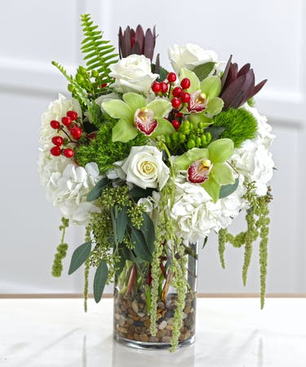
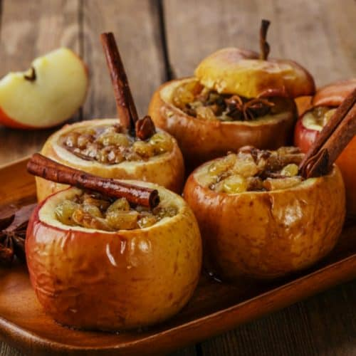
Creative Arts
Cook
Bake
Color
Paint
Ceramics
Flowers &/or plants
Sing
Poetry
Notes:
Faye

Slide 18
Caregiving Opportunities
Meaningful Role: Gives You the Ability to Help Rather than Feel Helpless
Enrichment: Satisfaction, Conﬁdence, Sense of Accomplishment in Providing Support
Inner Purpose: Hidden Strengths and Resources as well as Resilience
New Relationships: Friends & Support Groups
Family Sharing: Closeness & Openness, Bonding
Notes:
Cheryl

Slide 19
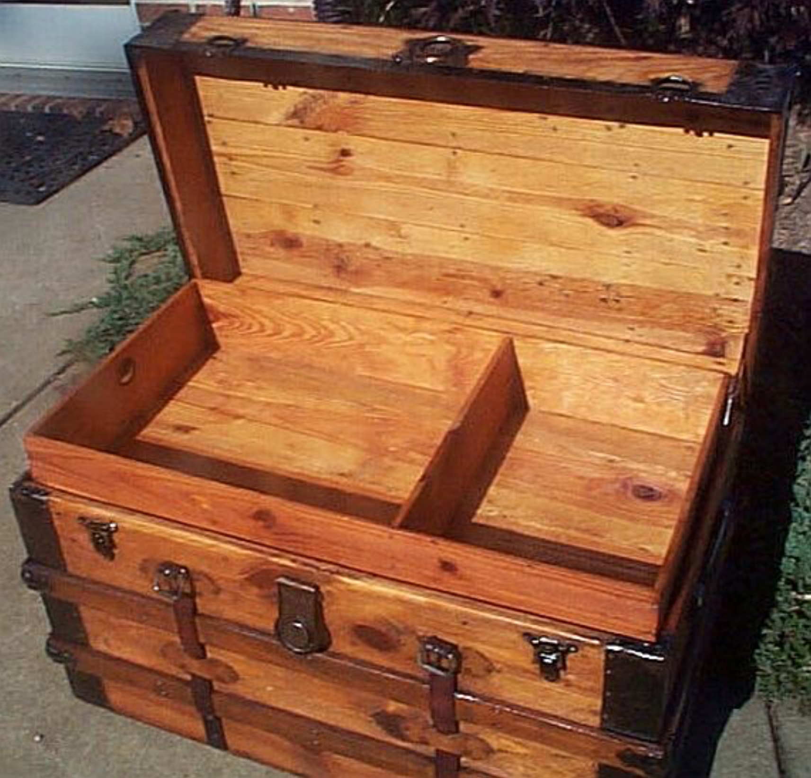
Blessings
Take a piece of paper and make a list:
What are the blessings or gifts that that you have received from caregiving? What do you want to put in your blessing trunk?
Notes:
Cheryl

Slide 20
Gratitude
In our tradition, we are encouraged to start our day with Modeh Ani מודה אני לפניך מלך חי וקיים שהחזרת בי נשמתי בחמלה. רבה אמונתך and to say/ acknowledge 100 blessings a day
Rabba Emunatecha- Rabbaynu Tzadok says it means Gd believes in us
Rabbaynu Nachman- We each have an inner tune & we need to teach children and ourselves to find their inner tune, inner spark
Notes:
Faye

Slide 21
Gratitude Journal
Keep a Gratitude Journal:
At the beginning of the journal, make a list of all the things you’re grateful for, in general.
At the end of each day, on a separate page, list the things you are grateful for that day. You can use words, or you can draw visual representations.
You might want to share this with the person who you are caregiving---and ask them what they are grateful for also.
Notes:
Faye

Slide 22
David Steindl-Rast, monk and interfaith scholar
Raised in Vienna as a Catholic, suffered because ¼ Jewish, As a family emigrated to US and became a Benedictine monk in 1953
When we are grateful
we are not fearful, not violent
Act of sense of enough, not sense of scarcity
Enjoying the difference between people and respectful to everyone
Future will be network, not a power pyramid.
World of grateful people is a world of joyful people
Notes:
Faye

Slide 23
Smile, laugh, enjoy life’s simple pleasures
Notes:
Faye

Slide 24
Be Mindful: Definitions
Merriam-Webster Dictionary: the practice of maintaining a non-judgmental state of heightened or complete awareness of one’s thoughts, emotions or experiences on a moment to moment basis
Cambridge Dictionary: practice of being completely aware of your mind, body and feelings in the present moment, thought to create a feeling of calm
Notes:
Cheryl

Slide 25
How to Practice Being Mindful
Take a seat. Find a place to sit that feels calm and quiet to you.
Set a time limit. If you're just beginning, it can help to choose a short time, such as 5 or 10 minutes.
Notice your body. ...
Feel your breath. ...
Notice when your mind has wandered. ...
Be kind to your wandering mind.
https://www.mindful.org/take-a-mindful-moment-5-simple-practices-for-daily-life/
Notes:
Cheryl--- meditation if time

Slide 26
We Will Be Blessed for Doing Chesed
Gemilut Chasadim – acts of kindness to each other, like the pasuk/ passage says in Hoshea, “כי חסד חפצתי ולא זבח – Gd prefers chesed over korbanot.” (kindness over sacrifices)
The Chofetz Chaim writes further that besides for the atonement that our chasadim bring, they also enable, kavayachol, Gd to bestow chesed upon us. Gd wants to shower us with beracha and Gd gave us ways to receive it. One of those ways is by doing chesed with others because that causes Gd, in turn, to do chesed with us.
Notes:
Faye

Slide 27
Resources
www.caregiver.com
Excellent resource for all aspects of caregiving and support groups
https://docs.google.com/document/d/1RPNoRklccM09hN5Cl1yAr1pBMvmcsvg5/edit
Spiritual Tools for Restoring Caregivers’ Spirits by Rabbi Dayle Friedman
https://www.caregiver.org/caregiver-statistics-demographics
Statistics related to the role of caregiver as a benchmark for you to realize that you are not alone! Also excellent resources at this website.
Notes:
Cheryl

Slide 28
Resources (Cont’d)
Family Caregiver Alliance and AARP Report on Caregiving in America
www.caregiver.org and www.aarp.org
National Alliance of Caregivers: www.caregiving.org
National Family Caregivers Association: www.caregiveraction.org
Alzheimer’s Foundation: www.alzfdn.org
American Cancer Society: www.cancer.org/treatment/caregivers
National Stroke Association : www.stroke.org/we-can-help/caregivers-and-family/careliving-guide

Slide 29
Resources: Seeking Help
Talk to someone you trust and respect to help with major psycho-social and financial needs and for referrals. Contact your network of friends for support as well.
Contact your local community and government services and medical insurance
Contact your Clergy Person or Caring Community in your synagogue
Call The Jewish Family Service in your area
In NYC: The Jewish Board 844-663-2255
In Miami area: Mishkan Miami, the spiritual connection for The Greater Miami
Jewish Federation: https://jewishmiami.org/connect/interest/mishkan-miami
or Jewish Community Services: 305-576-6550
Notes:
Faye

Slide 30
Websites to Help You Manage Caregiving Communication and Tasks
www.caringbridge.org Way for you to give information to those who need to know what is happening, so that you don’t need to respond to continuous email/ phones.
www.lotsahelpinghands.com Way for you to organize a support system for caretaking, where others can help attend to tasks such as driving to doctor’s appointments, shopping, cooking, or respite care for a family.
Familiarize yourself with local services such as: home care providers, care managers, activity programs and other service providers. Keep a database of resources to share, so that you can make recommendations to others.

Slide 31
Special Concerns and Resources
Placement for a Jewish adult with intellectual and or developmental disabilities- Mishkon 718-851-7100
Substance Abuse or misuse. Referrals- JACS-Jewish Alcoholics, Chemically Dependent Persons and Significant Others jacs@jbfcs.org 212-632-4600 https://jewishboard.org/listing/jewish-alcoholics-chemically-dependent-persons-and-significant-others-jacs/
Family Violence National Hotline at 1-800-799-7233 (SAFE)
Notes:
Faye

Slide 32
For Chesed or Caring Community Committees to Support Congregational Members Adapted from Source: AGIS and National Family Caregivers Association.
Start talking with loved ones about their wishes for future treatment and care.
Build a care team. Reach out to friends and neighbors. Have conversations about what might be needed in the future.
Gather records. Find and collect in one place all of the loved one’s ﬁnancial records, as well as any legal documents such as powers of attorneys and advance directives. List passwords for various accounts.
Start educating family about the loved one’s condition and the help you may need from others. For links to local programs, contact your local area community agencies.
Create a list of emergency contacts with all of the contact information, as well as that of doctors, services, neighbors, friends, and family who are involved in the loved one’s care. Keep copies prominently displayed at home and at work.

Slide 33
Prayer for You
May the One who blessed our ancestors be present
for you who provide help for someone in need.
May you be filled with fortitude and courage, sympathy and compassion,
as you give strength to those who need your care.
May you fight against despair and continue to find within yourself the ability
to reach out for support from others.
And in your caregiving, may you know the blessing of community,
the blessings of faith, family, and friendship.
Notes:
Cheryl

Slide 34
You Can Reach Out to Me
Rabbi Cheryl Weiner , PhD, BCC
Staff Chaplain and Community Rabbi for Mishkan Miami, Greater Miami Jewish Federation
Jewish Chaplain for Seasons Hospice, Broward, FL
Email: cweinermh@aol.com; Cell Phone: 954-770-2406
Notes:
Cheryl

Slide 35
You Can Reach Out To Me
Faye Wilbur, LCSW Director, Community Relations, Mishkon/Coordinator Special Projects Boro Park and Crown Heights Clinics -The Jewish Board fwilbur@jbfcs.org
Mishkon 718-435-5700 x 770209 Clinic 718-435-5700 x 770209
Private practice
Notes:
Faye

Slide 36
Thank you for all you do for the community
Notes:
Both of us

