Slide 1
Bereavement Groups to Find our Resilience
Rabbi Shira Stern, D.Min., BCC
ravshira@gmail.com
Notes:
They manage to survive, but how they do so eludes us.
Some people are born resilient; they always land on their feet despite any and all obstacles in their path. They manage their bad news, disappointments and disasters with remarkable aplomb. But what about the rest of us who are scared and confused and helpless when plans go awry? Is there a way for us to experience trauma or stress or difficulties and respond to them in a healing fashion? Can we learn something from the lives of others that will inform our behavior, so that we survive our bad breaks more readily? And is there a way to actually do more than survive – actually thrive – in life?
I struggled with the very definition of resilience, because for me, it is much more than simply the “power or ability to return to the original form, position, etc., after being bent, compressed, or stretched; [in other words – the definition of] elasticity.” We don’t stretch - we are not as malleable as stress balls, and contrary to the dictionary definition, we also never revert to our “original form.” We bear the scars, both internal and external, of trauma and misfortune. And sadly, we don’t always have “ the ability to recover readily from illness, depression, adversity, or the like; “we are certainly not “buoyant.” We carry with us the memories of the day, or moment or sometimes, the prolonged agony of a loved one hanging on to life.
I found great resonance in Carole Radziwill’s memoir entitled What Remains: A Memoir of Fate, Friendship, and Love. Having lost her husband at 36, his first cousin and her best friend within a three week period, she realized that “Resiliency is the ability to find one 's balance when your world has been shaken to its core.”

Slide 2
Bereavement Groups
We know that people react differently to common traumas, depending on their own experience of loss, their past coping mechanisms and their resources.

Slide 3
Bereavement Groups
Grief has a special language
Grief creates a special community
Grief is lonely

Slide 4
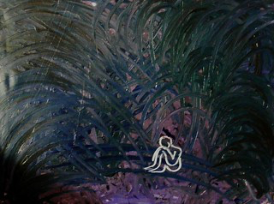
Grief
Because grief makes us look and feel vulnerable, many of us try to avoid it, at least in public. But it’s hard to gauge when something will really hit you.

Slide 5
Grief
Grief is not a straight line:
You’re awful, you get better, you’re good.
It’s done.
Notes:
Grief is not a straight line: you’re awful, you get better, you’re good. It’s done. Grief sometimes catches you completely off guard: some little trigger sets you off and you feel suddenly the way you felt months ago. You might even articulate that you’ve suffered a setback, but in reality, you’ve allowed yourself to feel the loss again acutely because you are better equipped to deal with it now that some time has passed. Lorraine has taught me this lesson often, and her resiliency lies not in her feeling good at any point in time, but in her feeling bad, experiencing it and finding her way back to an even keel. Even if it takes time

Slide 6
What we want Grief to look like

Slide 7
What Grief really looks like

Slide 8
Grief
Helping someone find their resilience means allowing them to nurture their own grief

Slide 9
The Five Stages of Grief by Linda Pastan
The night I lost you, someone pointed me towards the
Five Stages of Grief.
Go that way, they said, it’s easy, like learning to climb stairs after amputation.
And so I climbed.
Denial was first.
I sat down at breakfast, carefully setting the table
for two. I passed you the toast –
you sat there. I passed you the paper – you hid behind it.

Slide 10
Anger seemed more familiar.
I burned the toast, snatched the paper and read the headlines myself.
But they mentioned your departure and so I moved on to
Bargaining. What could I exchange for you?
The silence after storms? My typing fingers?

Slide 11
Before I could decide,
Depression, lame puffing up, a poor relation,
its suitcase tied together with string.
In the suitcase were bandages for the eyes and bottles of sleep.
I slid all the way down the stairs, feeling nothing.

Slide 12
And all the time Hope, flashed on and off in defective neon.
Hope was a signpost pointing straight in the air.
Hope was my uncle’s middle name, he died of it.
After a year I am still climbing, though my feet slip
on your stone face.

Slide 13
The tree line has long since disappeared; green is a color I have forgotten.
But now I see what I am climbing towards: Acceptance, written in capital letter “A” : special headline: Acceptance.
Its name is in lights. I struggle on, waving and shouting.
Below, my whole life spreads its surf, all the landscape I’ve ever known or dreamed of. Below a fish jumps: the pulse in your neck.
Acceptance. I finally reach it. But something is wrong.

Slide 14
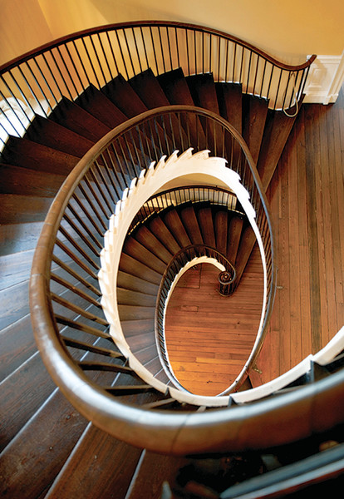
Grief is a circular staircase.
I have lost you.

Slide 15
Bereavement Groups: Not time/loss/gender/age specific
Some groups benefit from specific parameters (ie., those who have survived after a loved one died by suicide)
Other groups benefit from on-going, non-specific criteria that do not impose any limits on participation

Slide 16
Benefits of this Safe Space
Recent mourners can visualize how moving forward might look to them
Veteran mourners can gauge how far they have come
Mourners can tell their stories without fear of hurting their loved ones
Mourners can remember incidents that are triggered by the stories of others
Mourners can create a community, even when some members come and go and then return

Slide 17
Some Constants
Loss is loss is loss
Loss is isolating
Loss is layered
Wonderful memories
Difficult memories
Memories that evoke anger
Memories that evoke feelings of abandonment
Feelings of Loss can be mitigated by community

Slide 18
Creating Community
Strong facilitator
Allows for free discussion
Limits monopolizing by any one participant
Encourages the more hesitant to share their stories

Slide 19
Creating Community (2)
Basic structure
Intro and rules (absolute confidentiality, kindness)
Quick check in
Short opening meditation/song

Slide 20
Creating Community (3)
Continuity of sessions
No cancellations except
weather
holiday related restrictions
Alternate Facilitator if necessary

Slide 21
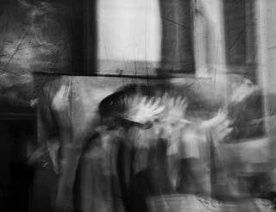
Grief Lesson #1
Grief is complicated

Slide 22
Grief lesson #2
None, never, NO “shoulds” in Grieving

Slide 23
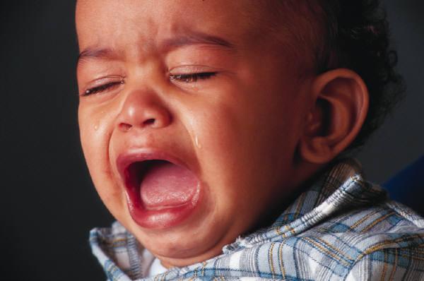
Grief Lesson #3
Grieving requires time, and every person moves through the grieving period at their own pace
Notes:
Being aware that you and your congregants will also be affected even if the disaster did not touch you directly

Slide 24
Grief lesson #4
Sharing your narrative, in your own time and in your own way, helps propel the healing process.
(it ain’t easy. Nope. Not at all.)

Slide 25
Grief Lesson #5
It’s never one and done, no matter how much we want it to be

Slide 26
Resources

Slide 27
Useful Tools
Introducing Holiday-related themes:
Yizkor on Yom Kippur, Pesach, Shavuot and Sukkot
Blue Services
Counting the Omer by writing down one separate memory for each of the 49 days
Sharing one gift that their loved one taught them each night of Chanukah
Sharing pictures when a new member enters the group

Slide 28
Healing Service within a Bereavement group
Modified Healing Service on Yom Kippur with targeted messages:
Healing ourselves after a death
Insertion of El Malei and Kaddish
Acknowledgement of:
First Yizkor
First loss of parent
First loss of partner/spouse/child/friend

Slide 29
Goal of Bereavement Groups
Abraham Joshua Heschel teaches us that there are three ways to mourn;
first to cry out,
then to grow silent,
and then to turn our sorrow into song."
But the only wait to do that is to help people to articulate the narrative

